Slide 1
YouTube Video Downloader
Mini Project Presentation
ABHYUDIT SINGH
23FE10CSE00790

Slide 2
Introduction
This project is a Python-based application that enables users to download YouTube videos with a user-friendly GUI created using Tkinter.
Objective: Simplify video downloads without third-party tools.

Slide 3
Tools and Technologies
• Python 3.x
• yt-dlp for video downloads
• Tkinter for GUI development
• IDE: [e.g., PyCharm, VS Code]

Slide 4
System Workflow
1. Input: User pastes the YouTube video link.
2. Processing: yt-dlp fetches and downloads the video.
3. Output: Video saved to the system with status updates.

Slide 5
Key Code Snippets
GUI Design with Tkinter.
Function to handle video downloads using
yt-dlp.
Error handling for invalid links and user feedback.

Slide 6
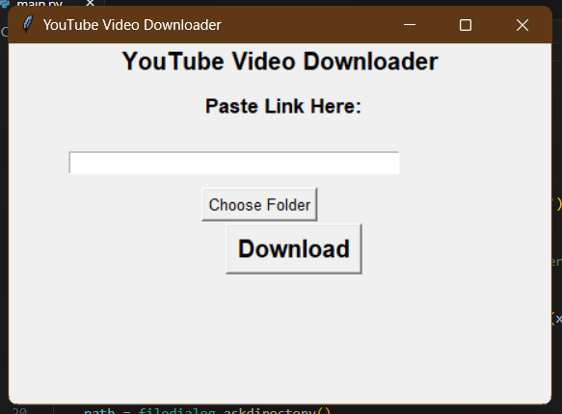
Demo
Screenshots or video of the program running:
1. Input window.

Slide 7
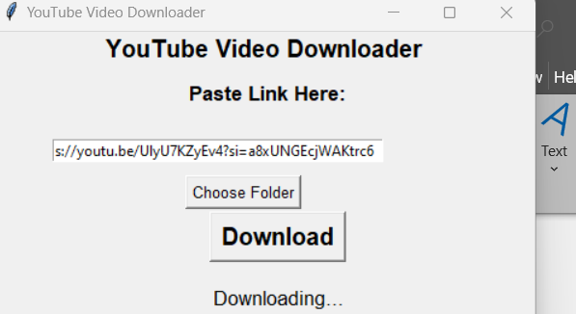
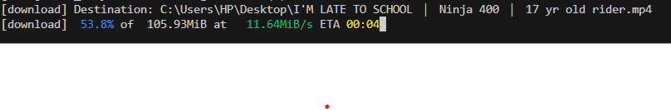
2. Download Status

Slide 8
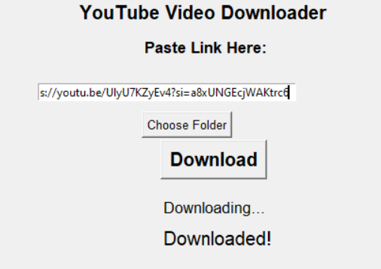
3. File saved message.

Slide 9
Challenges and Solutions
Issue: Deprecated libraries like pytube caused errors.
Solution: Switched to yt-dlp for stable functionality.
Enhanced code for better error handling.

Slide 10
Conclusion
This project showcases the use of Python for building practical tools.
Future Enhancements:
a. Add playlist download functionality.
b. Support for more file formats.

Slide 11
References
yt-dlp Documentation
Python.org
Stack Overflow for debugging assistance

